Slide 1


KJ’s Educational Institute Trinity Academy of Engineering, Pune (Accredited by NAAC with ‘A’ Grade) DEPARTMENT OF COMPUTER ENGINEERING BE-Seminar Review – IV Project Presentation by GROUP 1 1. Gayatri Gaikwad 2. Mihir Bhattad 3. Sanyukta Holkar 4. Pritamsingh Solanki
DATE:28/04/2023

Slide 2
PROJECT NAME
PLANT DISEASES DETECTION AND CURE RECOMMMENDATION USING MACHINE LEARNING TECHNIQUES

Slide 3
LIST OF CONTENT
Introduction
Problem Statement
Objectives
Requirement analysis
System Requirement
Database Requirement
Convolutional Neural Network
Project Flowchart
Implementation Details
Results/Output
Advantages
Conclusion

Slide 4
INTRODUCTION
In Indian Economy Agriculture plays a very important role.
It is because as we know India is the second most populate country in the world, so for Living agriculture is must.
Wherever now a days farmers are facing many problems such as various diseases which are affecting the production of crops.
There are many applications already present in the market but they lack in giving cure on the detected diseases.
To overcome these problems we are trying to develop an application which will detect the disease and suggest it’s cure.
The main motive of our project is to reduce the time require for disease detection and it’s treatment.

Slide 5
PROBLEM STATEMENT
To classify and detect the diseases in plant and suggest the pesticide as remedy to it to improve it

Slide 6
OBJECTIVES
To create a system that is capable of precisely detecting agricultural disease at the early stage.
To recommend pesticide to the detected disease.
To improve the cultivation of healthy crops.
To reduce the time taken in predicting the diseases and suggesting the pesticide for it.

Slide 7
REQUIREMENT ANALYSIS
Safety Requirement:
The application is designed in modules where affected part in plants can be detected and fixed easily.
This makes it easier to install and update new functionality if required.
Technical risks:
If the model training get interrupted because of any reason then system can not give accurate result.
Backup plan:
We are going to make copy of model so if the model training get interrupt or fail then we can go with previous copy of model.

Slide 8
SYSTEM REQUIREMENT
Hardware Requirements:
System : Intel I5 Processor.
Hard Disk : 40 GB.
RAM : 8
Software Requirements:
Python 3.8.16
Pip 20.2.2
Anaconda Navigator
IDE: Spyder
SQLite DB

Slide 9
DATABASE REQUIREMENT
CROPS USED & IT’S DISEASE: -
Apple : Apple Scab Disease
Strawberry : Strawberry Leaf Scorch Disease
Corn : Corn Northern Blight Disease

Slide 10
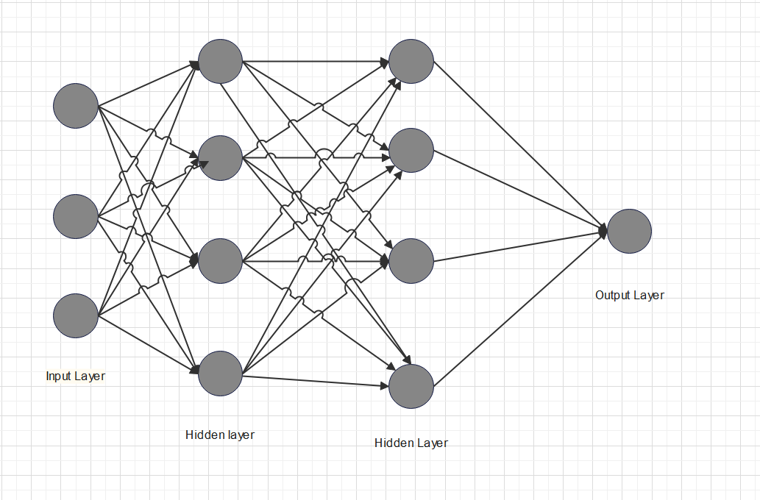
CONVOLUTIONAL NEURAL NETWORK
Fetch the trained model from Layer.
Loading the image of the same size as the one used in the training images.
Convert the image into an array.
Transform the numbers in the array to be between 0 and 1 by dividing by 255.
These are the steps used to training the CNN (Alex Net).
Step 1: Upload Dataset.
Step 2: The Input layer.
Step 3: Convolutional layer.
Step 4: Pooling layer.
Step 5: Flattened

Slide 11
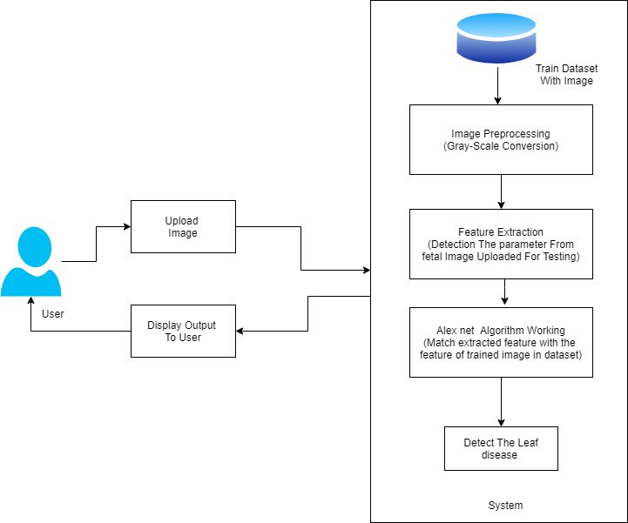
PROJECT FLOWCHART:

Slide 12
IMPLEMENTATION DETAILS:
INPUT: -
Login/Registration
Image
Pre-processing dataset
Feature Extraction
OUTPUT: -
Detect the Plant Leaf Diseases and Cure Recommendation
LANGUAGE USED: -
Fronted :Tkinter
Backend : Python

Slide 13
IMPLEMENTATION DETAILS :
Modules / Process: -
1) Register
2) Login
3) Import Data(image)
4) Pre-processing Dataset
5) Feature Extraction
6) CNN model
7) Output
Implementation Done

Slide 14
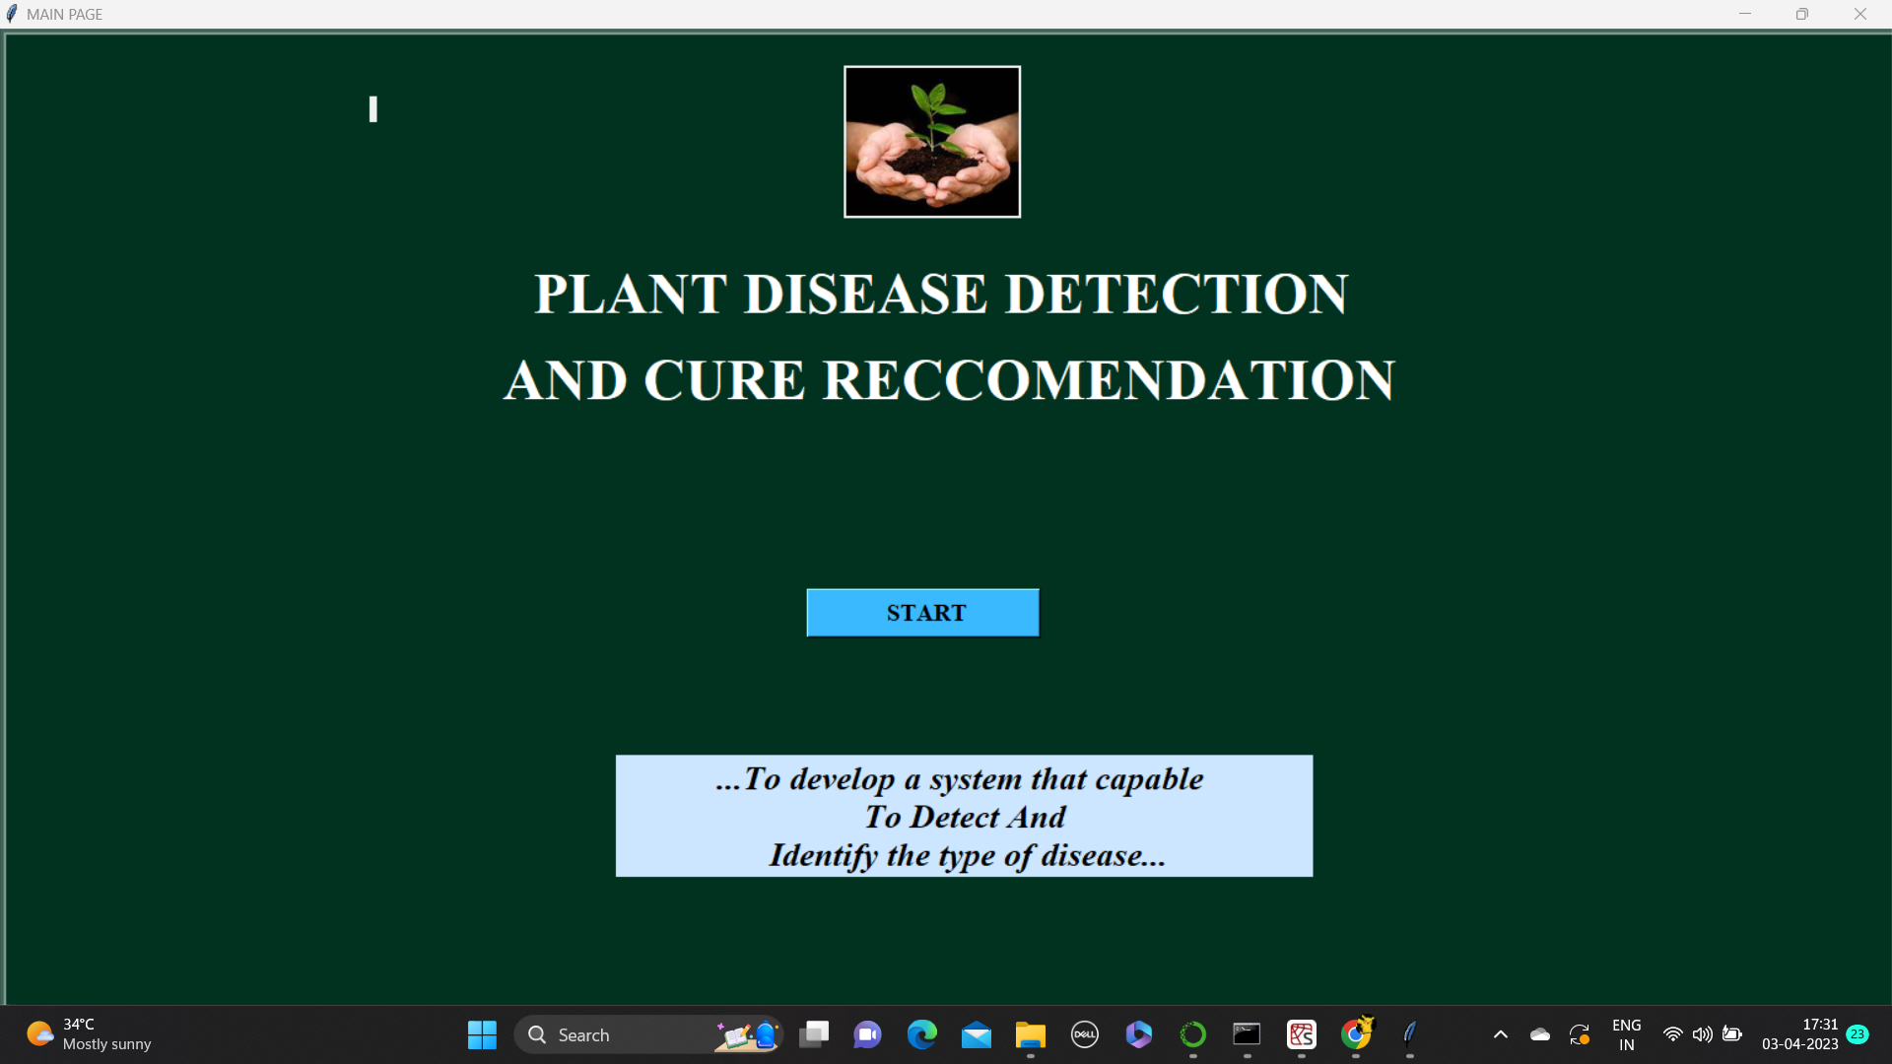
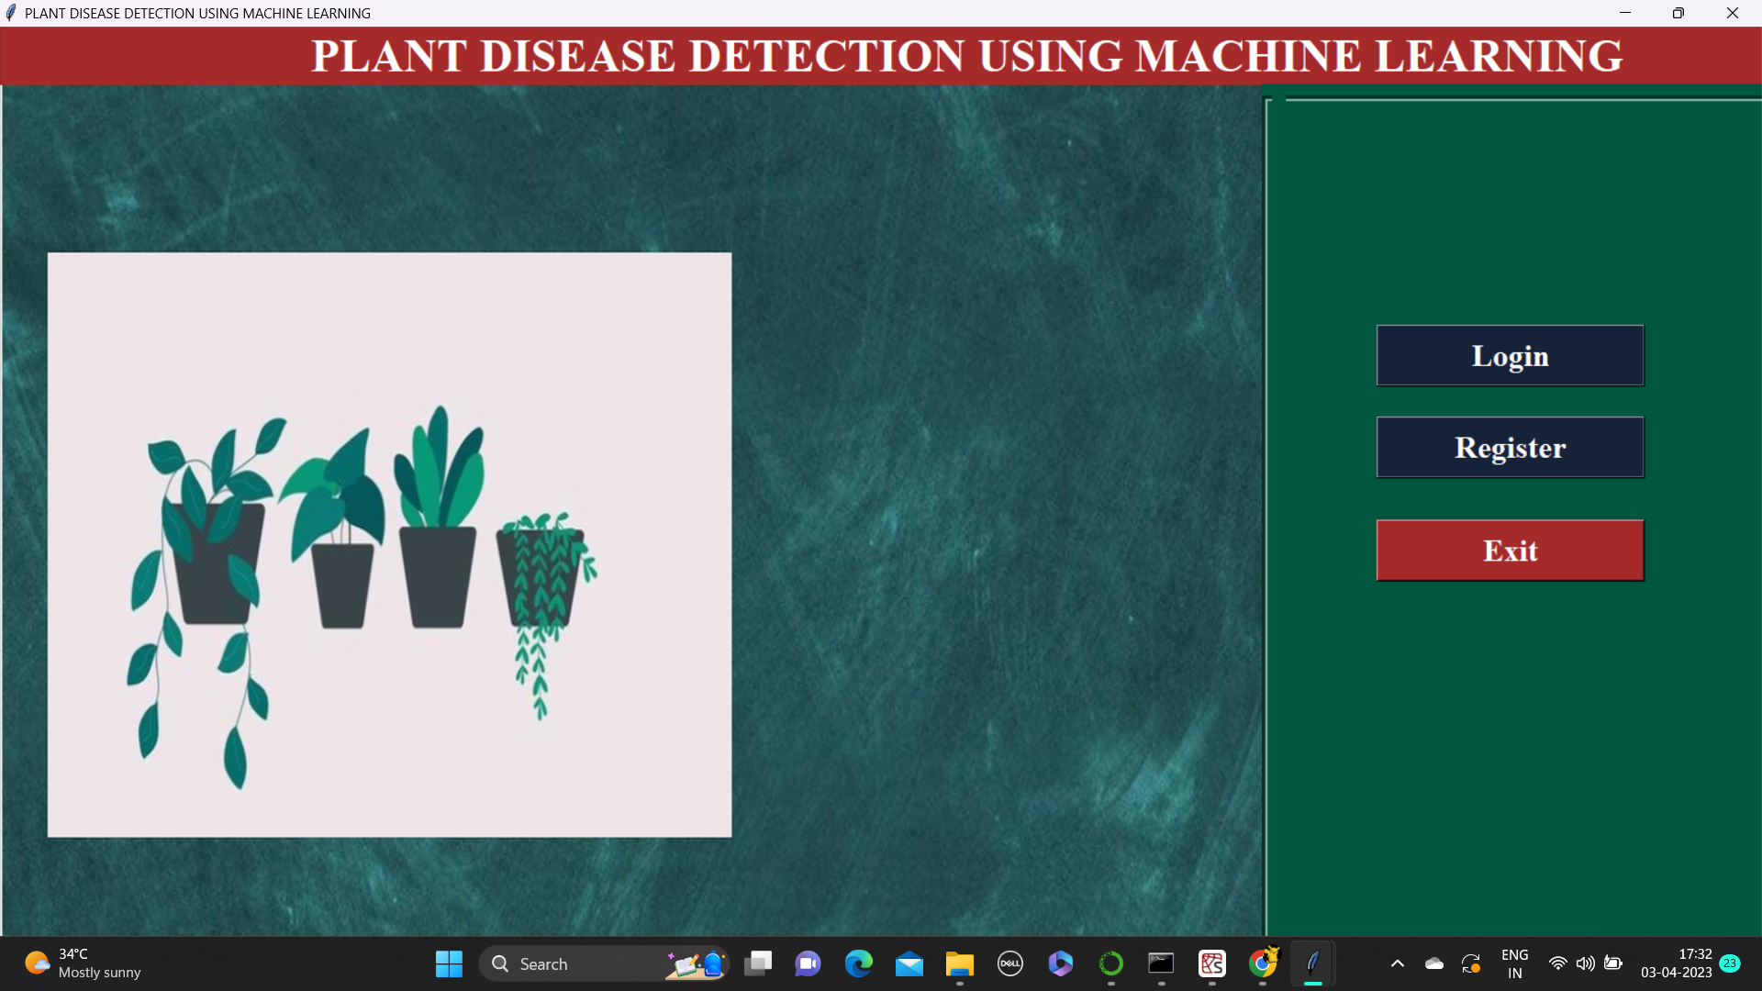
IMPLEMENTATION DONE:
GUI : MAIN PAGE

Slide 15
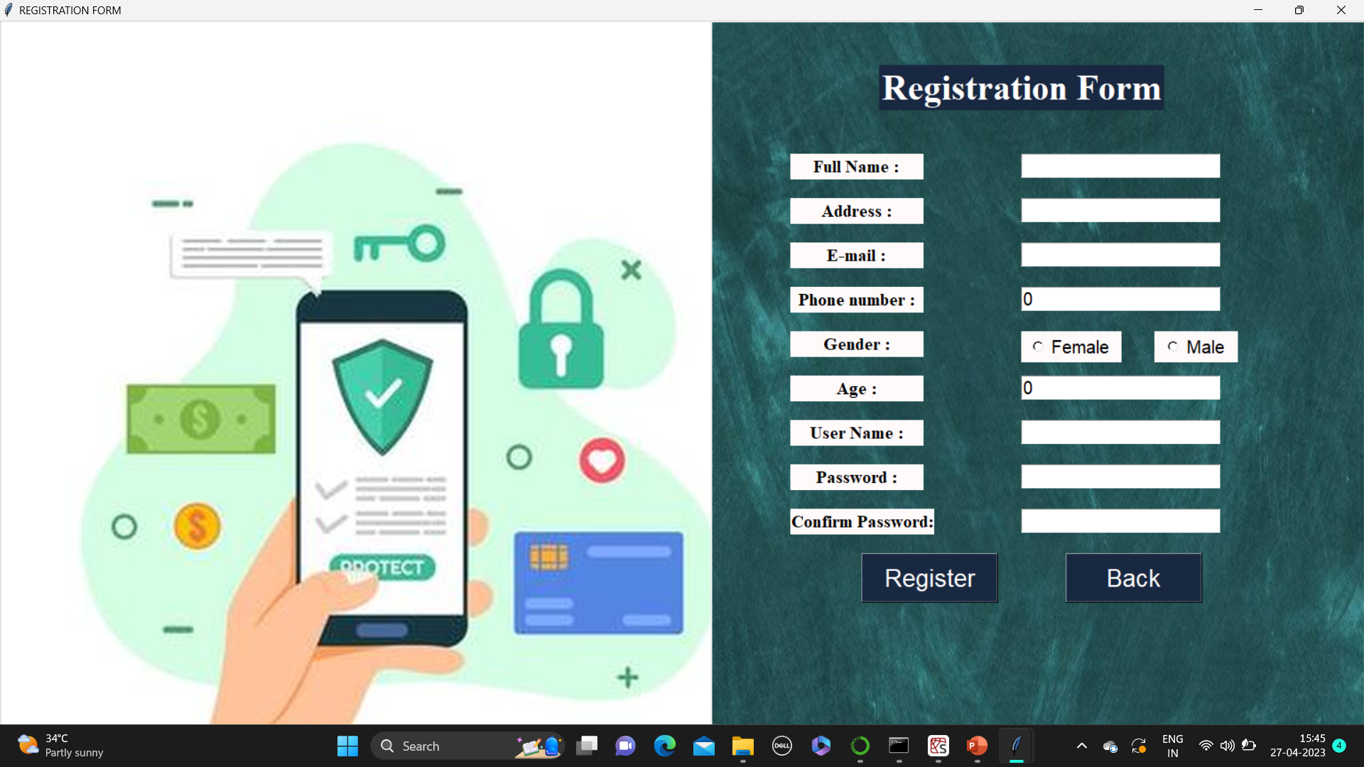
IMPLEMENTATION DONE:
MODULE 1 : REGISTRATION

Slide 16
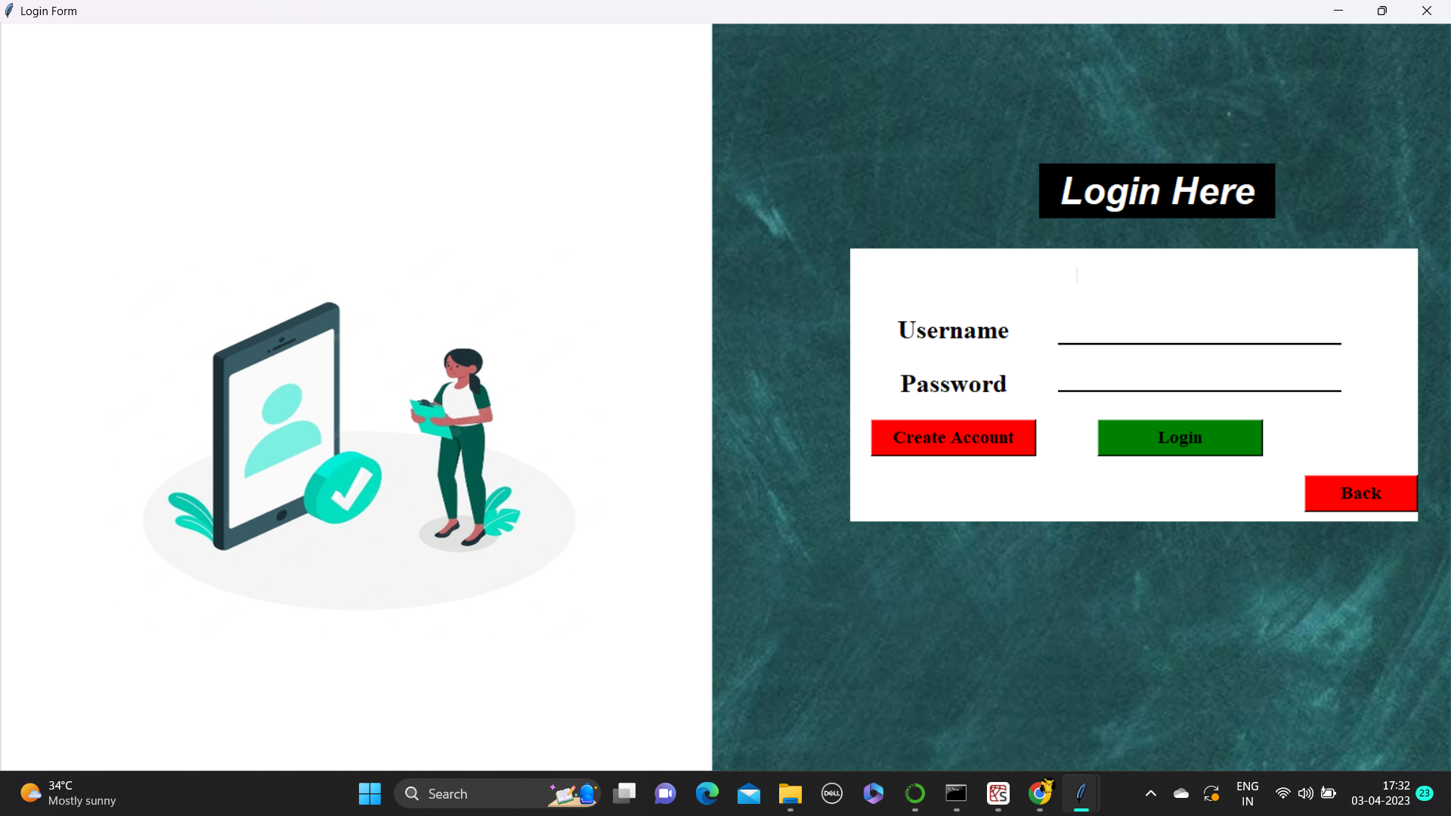
IMPLEMENTATION DONE:
MODULE 2 : LOGIN

Slide 17
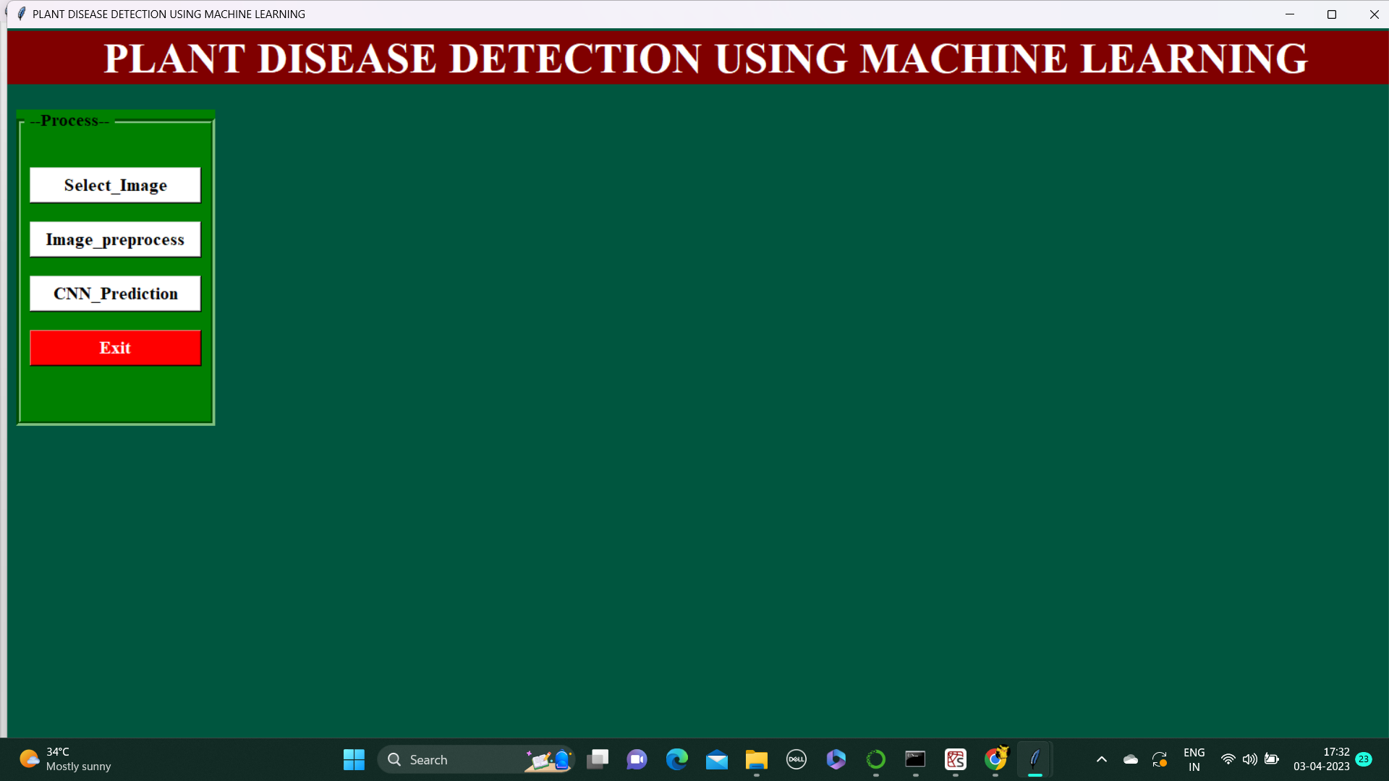
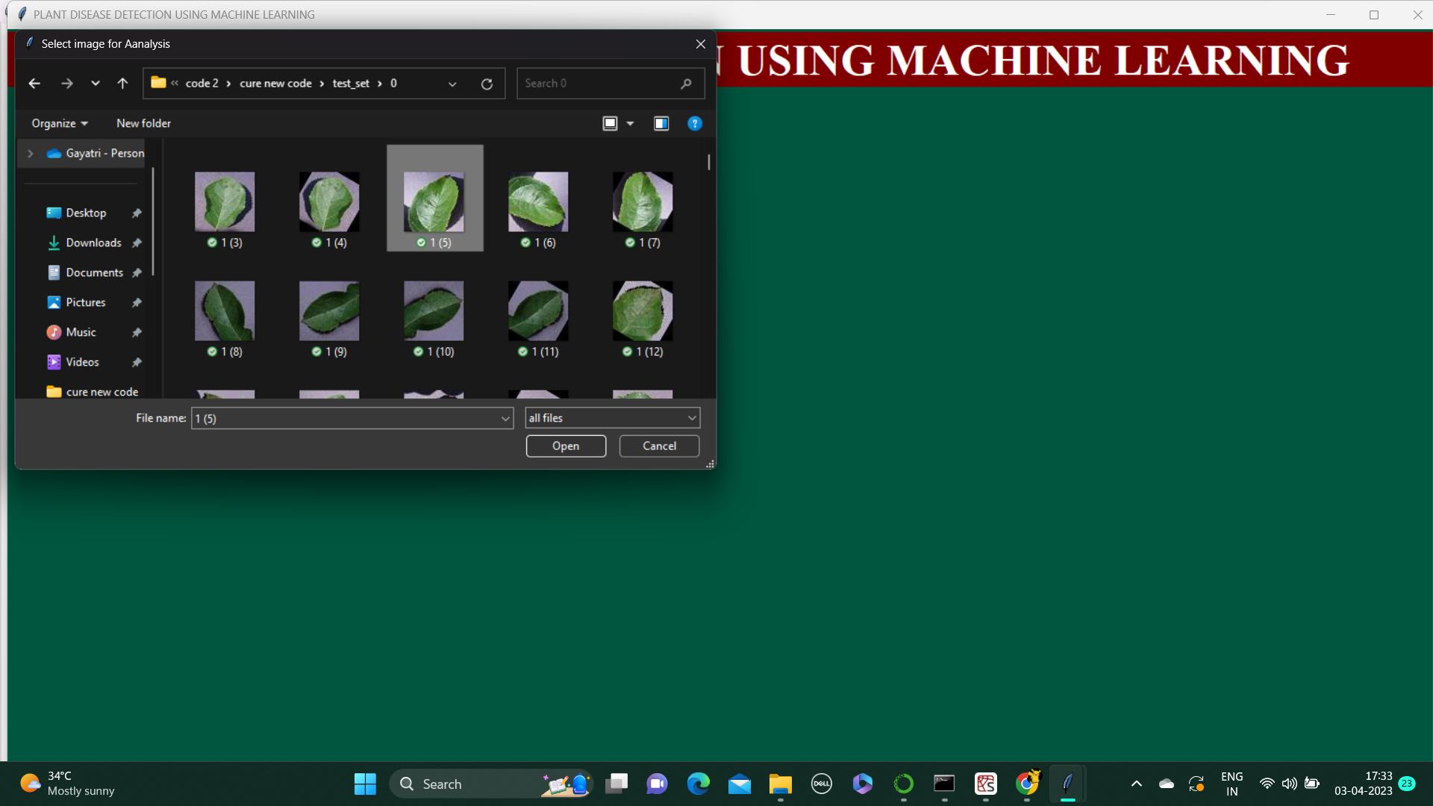
IMPLEMENTATION DONE:
MODULE 3 : IMPORT DATA

Slide 18
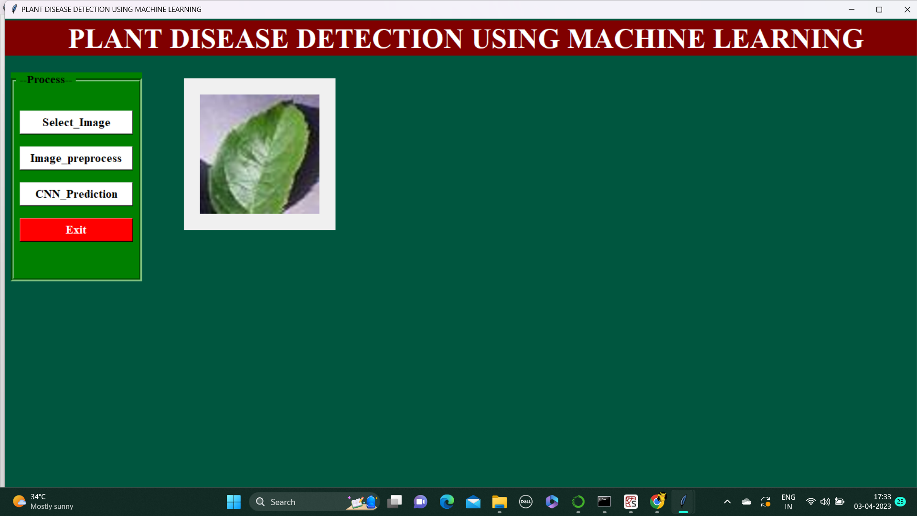
IMPLEMENTATION DONE:
MODULE 4 : PRE-PROCESSING DATA

Slide 19
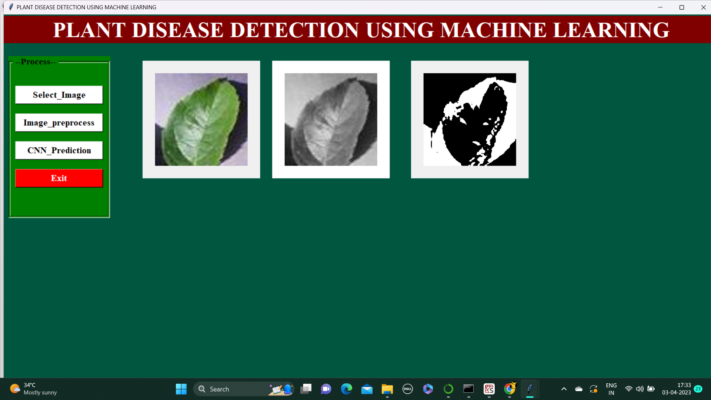
IMPLEMENTATION DONE:
MODULE 5 : FEATURE EXTRATION

Slide 20
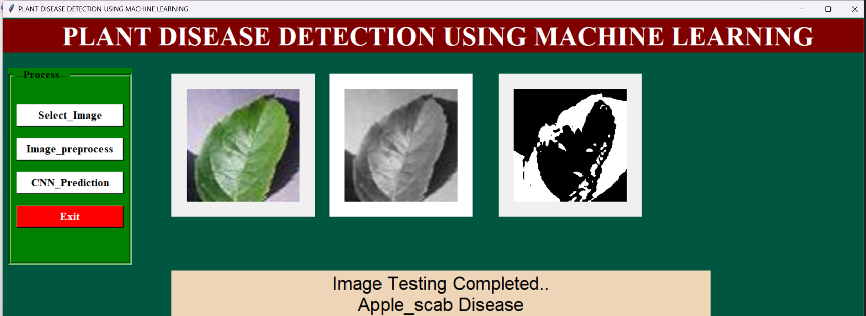
IMPLEMENTATION DONE:
MODULE 6 : CNN MODEL

Slide 21
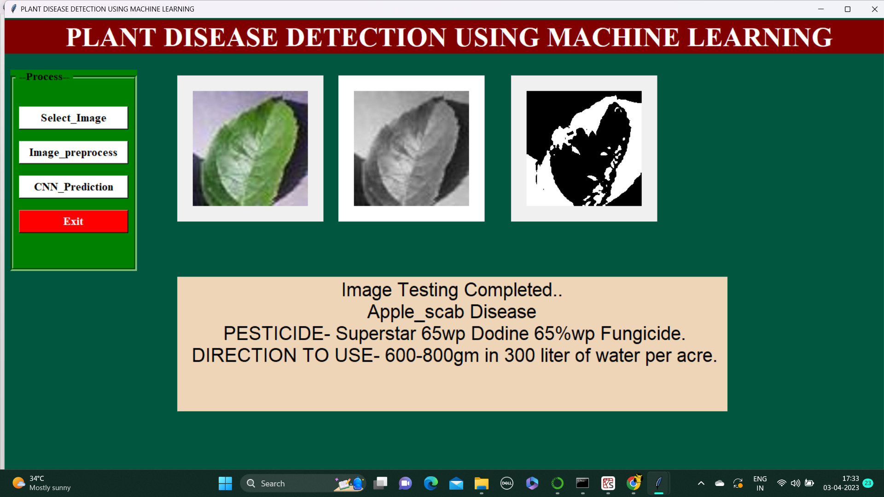
IMPLEMENTATION DONE:
MODULE 7 : OUTPUT

Slide 22
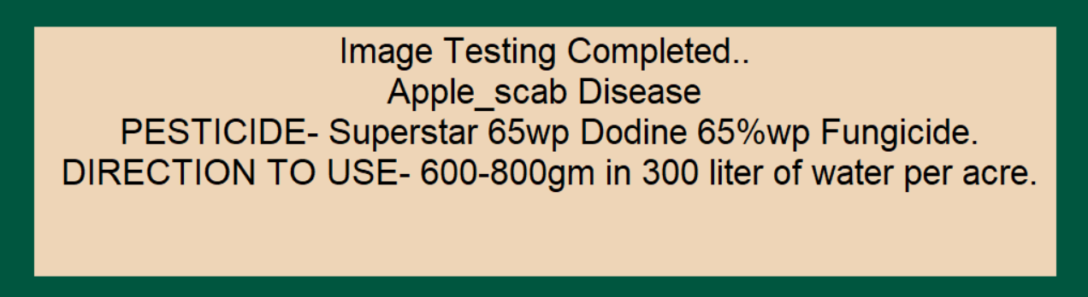
RESULTS / OUTPUT

Slide 23
ADVANTAGES:
To help farmers by identifying the disease present in their plants leaves and to provide the best possible solution for that disease.
To enhance the productivity of farming and to develop the interest towards farming.
To reduce the effort of farmer in terms of time and money.

Slide 24
CONCLUSION
The main motive of this presentation was:
To solve the problems of farmers in getting the required yield
To highlights the different literatures, which reflects various methodologies to detect the diseases in crops

